Slide 1
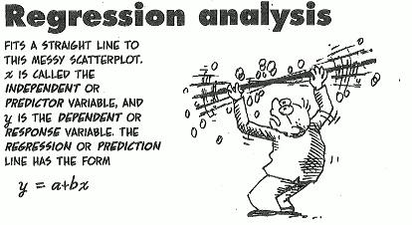

Welcome To….
(Part-1)

Slide 2
Learning Outcomes
When you will complete this chapter, you would be able to-
Development of Mathematical Equation for modeling the relationship of the variables.
Use of the Equation for the purpose of prediction.

Slide 3
Outlines
From this lecture, you are going to learn…
Definition of Regression with Examples
Define Independent and Dependent variables
Types of Regression with definition (Simple & multiple)
Fit/ Estimate Simple linear regression Line/model
Estimation of regression coefficients with interpretation
Interpret Coefficient of determination
(Part-1)
(Part-2)

Slide 4
Regression with Examples
Regression analysis:
It is concerned with the study of forming a mathematical equation of the dependence of one variable (the dependent variable) on one or more other variables (the independent variables).
Examples:
The marketing director of a company may want to know how the demand for the company’s product is related, to say advertising expenditure.
Suppose the sales manager of a company say X, wants to determine how the number of credit cards sell is related to the number of call.

Slide 5
Dependent and Independent variables with Example
Dependent variable: The dependent variable is the variable being predicted or estimated. It is denoted by y.
Independent variable: The Independent Variable provides the basis for estimation. It is the predictor variable. It is denoted by x. It is also called as Explanatory variable.
Example:
If we want to know the expected weekly production of a company then production will be the dependent variable and the predictor/independent variables could be the capital, number of labors engaged, supply of raw materials etc.

Slide 6
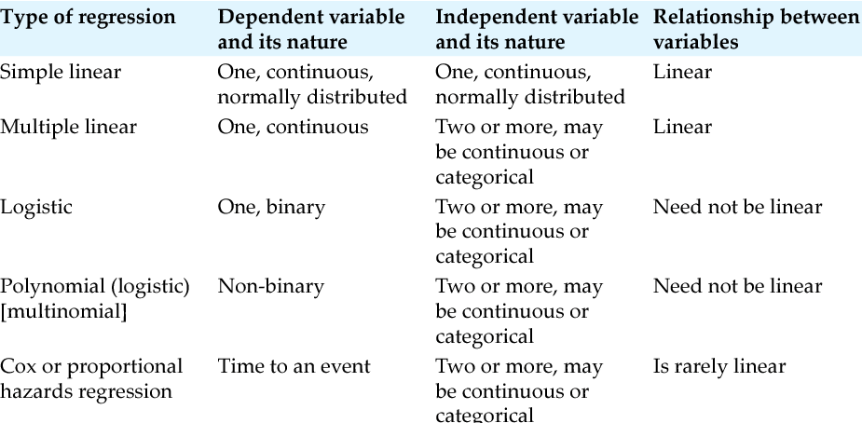
Types of Regression Model
Based on number of variables Regression model is of 2 types:
Simple Regression model
Multiple Regression model
Based on nature of dependent variables Regression model is of several types:
Linear Regression Model
Logistic Regression Model and so on.

Slide 7
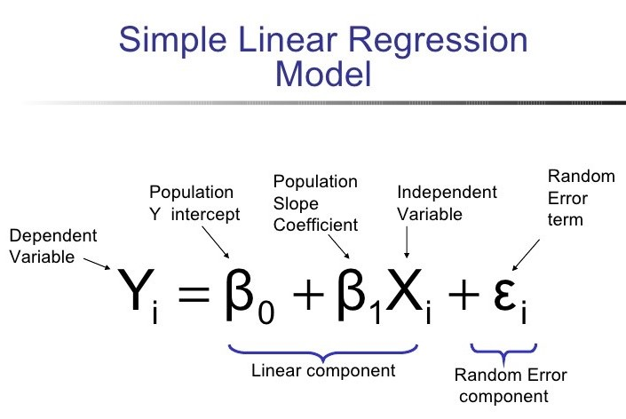
Simple Linear Regression Model with Example
Simple Linear Regression Model :
Regression model that consists of one dependent variable and one independent variable is called simple regression model.
Suppose here,
X= Income and
Y= Expenditure

Slide 8
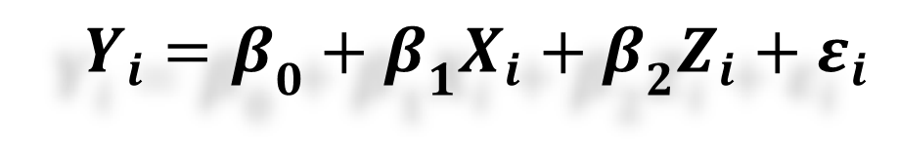
Multiple Linear Regression Model with Example
Multiple Linear Regression Model :
Multiple Linear Regression Model :
Regression model that consists of one dependent variable and more than one independent variables is called multiple regression model.
$$Y_{i}=β_{0}+β_{1}X_{i}+β_{2}Z_{i}+ε_{i}$$
Suppose here,
X= Income
Z= Family Size and
Y= Expenditure

Slide 9
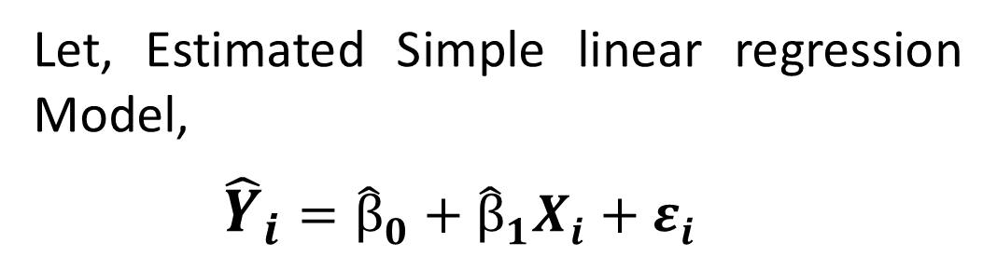
Estimate Simple linear regression Model
Let, Estimated Simple linear regression Model,
$${\hat{Y}}_{i}={\hat{β}}_{0}+{\hat{β}}_{1}X_{i}+ε_{i}$$
Formula of getting the value of regression coefficients:
Slope
Intercept

Slide 10



